Slide 1

Introduction to Android Studio

Slide 2
Android is Freedom
Android is open source
Free SDK(Software Development kit),IDE and emulator
No Restriction; access anything*
Faster Access ( Update)
Distribute your app anywhere(PlayStore)

Slide 3
System requirement
Minimum 4GB RAM
(recommended 8GB)
2-3 GB of Available disk space minimum
(500 MB for IDE + 1.5 GB for SDK )

Slide 4
Install Android Studio
1)Install JDK
2) Set Path for JDK
3) install SDK

Slide 5
Installation
Need to install Java Development Kit (JDK) to write Java (and Android) programs
Can download the JDK for your OS at http://java.oracle.com
Alternatively, for OS X, Linux:
OS X:
Open /Applications/Utilities/Terminal.app
Type javac at command line
Install Java when prompt appears

Slide 6
After installing JDK, download Android SDK from http://developer.android.com
Simplest: download and install Android Studio bundle (including Android SDK) for your OS
We’ll use Android Studio with SDK included (easy)

Slide 7
Strongly recommend testing with real Android device
Android emulator: very slow
Faster emulator
Easy to access

Slide 8
Testing
Open the Developer Options screen on your Android. See Configure On-Device Developer Options.
Select Enable USB Debugging.
On your development machine, open Chrome.
Go to chrome://inspect#devices.
Make sure that the Discover USB devices checkbox is enabled.

Slide 9
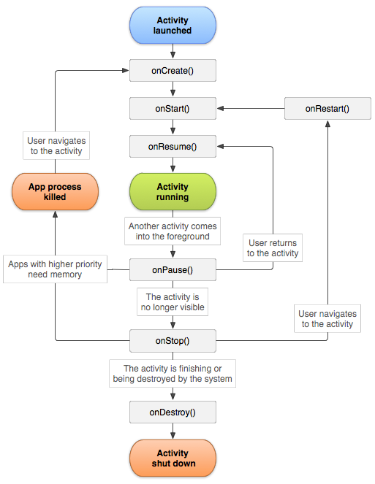
Activity Lifecycle

Slide 10
Files
mainActivity.xml
mainActivity.java
App Manifest

Slide 11
.
App Manifest
Every Android app must include an AndroidManifest.xml file describing functionality
The manifest specifies:
App’s Activities, Services, etc.
Permissions requested by app
Minimum API required
Hardware features required, e.g., camera with autofocus
.

Slide 12
Thank You

